Slide 1
Bloomer: Early Warning System
NASA Space Apps “To Bloom or Not to Bloom”
20 Oct. 2019

Slide 2
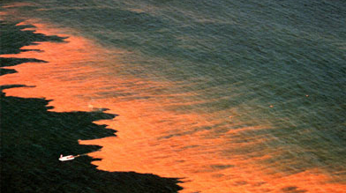
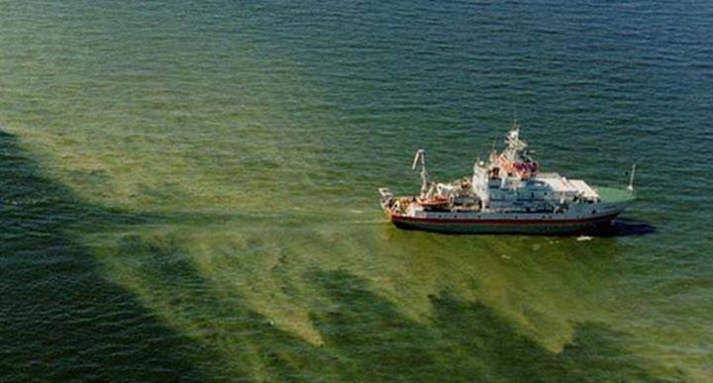
What are Algal Blooms
Algal blooms are rapid growths of algae
Typically one species is dominant in a bloom
Can occur in fresh or marine waters
Harmful Algal Blooms (HABs) cause devastating health effects
Toxins are released into waterways
Bacteria growth post-bloom causes dead zones
NASA’s Moderate Resolution Imaging Spectroradiometer (MODIS) has been successfully used to monitor blooms ¹
[img] National Centre for Coastal Ocean Science. Phytoplankton Monitoring Network (PMN). Online. 2019. https://coastalscience.noaa.gov/research/stressor-impacts-mitigation/pmn/image-gallery/bloom-mortality-events/
[1] Mati Kahru and B. Greg Mitchell. MODIS Detects a Devastating Algal Bloom in Paracas Bay, Peru. Eos, Vol. 85, No. 45, 9 November 2004

Slide 3
Economic Impact: Billions of Dollars Worldwide
Farming & Agriculture
Losses of ~$34 MM/yr in US markets ²
These industries also compose 10-50% of Southeastern Asian countries’ GDP ³
Healthcare
HAB-associated illnesses in humans and animals incur tens of millions in the US alone in direct healthcare costs ⁴
Tourism & Recreation
HABs result in closures of parks & waterways, restricting tourism ($10 - $200 MM/yr in US) ²
Environmental
Cause dead zones & mass mortality in water bodies ⁵
Further harm endangered species and key species in marine food chains ⁵
[2] Anderson DM, Hoagland P, Kaoru Y, White AW. Estimated annual economic impacts from harmful algal blooms (HABs) in the United States. 2000;WHOI-2000-11.
[3] World Bank World Development Indicators (2019), http://datatopics.worldbank.org/world-development-indicators/themes/economy.html;
[4] Florida Department of Health. Harmful Algal Blooms – Economic Impacts. pdf. 2008.
[5] Leanne J. Flewelling,* Jerome P. Naar,† Jay P. Abbott,* Daniel G. Baden,, et al. Red tides and marine mammal mortalities. Nature. 2005 Jun 9; 435(7043): 755–756.
Notes:
The recreation and tourism industries loses millions of dollars each year. For example, a harmful algal bloom event in a single lake in Ohio cost $37 to $47 million in lost tourism revenue over two years.

Slide 4
What Causes Blooms? Many Factors
Algae Bloom
Initial Population
Change in Population
Growth
Death
Introduction & Removal
Nutrients
Energy
Sunlight
Heat
Phosphorus Concentration
Nitrogen Concentration
Dissolved Oxygen
Predator Population
Natural Lifespan & Lifecycle
Water Currents
Competitor Population
Spectral Reflectance
Causes of algal blooms are not clear, however multiple contributing variables are known
Remote sensing can measure multiple of these variables via:
Direct imaging
Estimation from image channels
Other variables must rely on ground-based measurements
Models combining these factors are needed to predict blooms

Slide 5
Bloomer: Early Warning System
Satellite & Ground Data
Bloomer Early Warning System
Public & Subscription Web Service
A prediction service can provide early-warning to critical infrastructure & industries
Free public access to current satellite images & public health notices
Subscription-based integrated analytical services to government, corporate, and research bodies
Provide information on effectiveness of control methods

Slide 6
Bloomer Architecture
Multispectral images captured by NASA’s Moderate Resolution Imaging Spectroradiometer (MODIS)
Integrate ground measurements (e.x. Phytoplankton Monitoring Network) to predict blooms
Deliver data visualizations via web app: earlybloomers.co
Multispectral Images
Web Application
Images & Health Warnings by Location
Time-Series Analysis of Measurements
Kmeans Classifier
Space Segment
Ground Segment
User Segment
Provide early warning alerts
Ground-based data collection

Slide 7
System Level Diagram
MODIS Database
Lat., Long.
Year, Day
2400 x 2400 x 14
HyS Image
MODIS API Module
Ground Measurement
Lat., Long.,
Year, Day
2400 x 2400 x 3
RGB Image
Location, Time
Algae Population,
Location, Time
Preprocessing Module
Classifier Module
Web Domain
Public User Interface
False
Colour
Image

Slide 8
Data Preprocessing
Image Acquisition
Raw image from MODIS
Sun Angle Correction
Dark Object Subtraction
Correct for seasonality ⁶
Correct atmospheric effects ⁶
Sinusoid Correction
Flatten ‘curved’ image for screen viewing
Cropping & downsampling
[6] MacDougall, M.J., Waller, M.K.E. 2018. Remote Sensing of Terrestrial Phosphorus at a Watershed Scale: A Case Study from the Pefferlaw/Uxbridge and Beaver Sub-watersheds of Lake Simcoe – Technical Report. Project LS-16-17-004. St. Lawrence River Institute of Environmental Sciences, Cornwall, ON

Slide 9
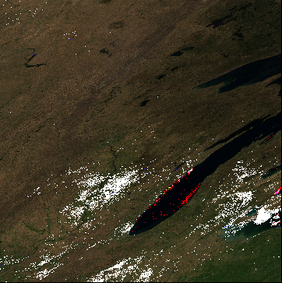
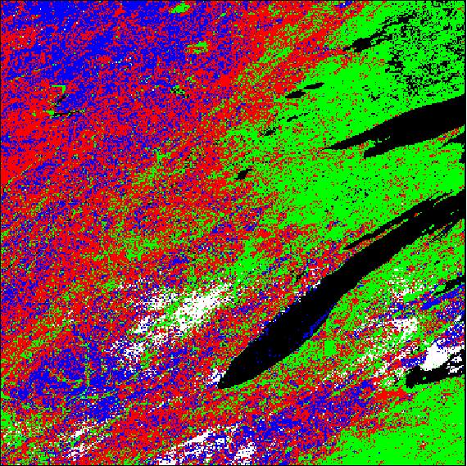
Image Analysis Model
Materials absorb/reflect different wavelengths of light, producing a unique image signature
Ratios of different spectral wavelengths provide further identifying information ¹²
Kmeans classifier with the Spectral Angle Map metric to classify regions in MODIS data
Model uses MODIS Band 1 (620 – 670 nm), and Band 4 (545 – 565 nm), and Band 3 (459 – 479 nm)
These bands correspond to chlorophyll A & B
Code available at https://github.com/aerjay/algal-blooms
[12] Rashmi S, Swapna Addamani, Venkat, and Ravikiran S. Spectral Angle Mapper Algorithm for Remote Sensing Image Classification. IJISET - International Journal of Innovative Science, Engineering & Technology, Vol. 1 Issue 4, June 2014.

Slide 10
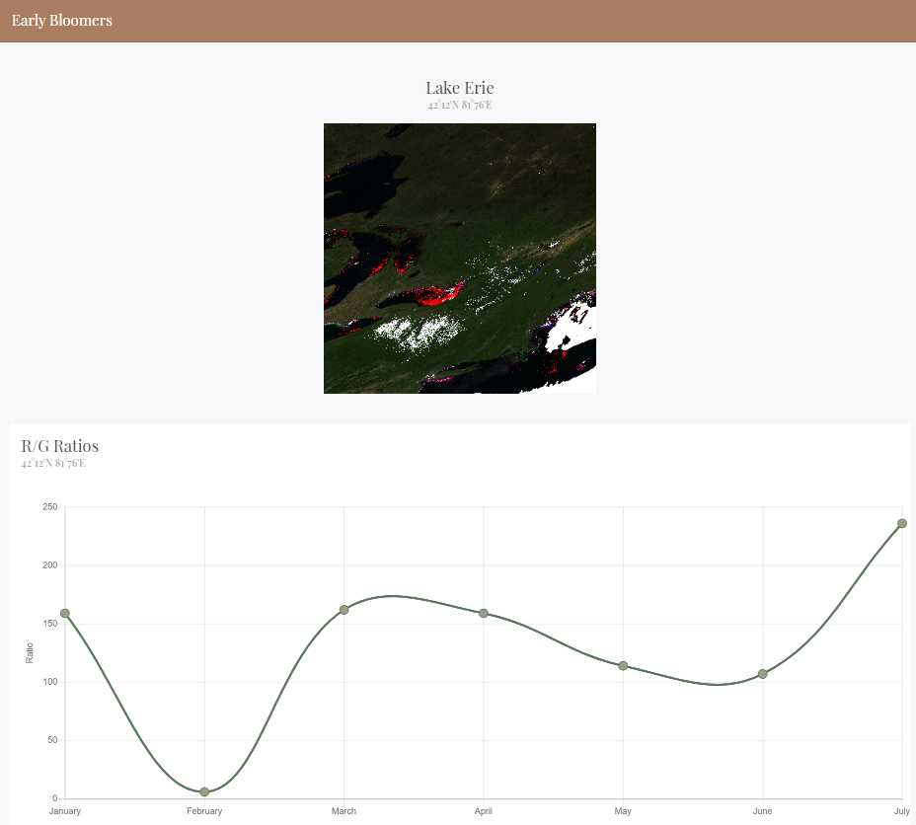
Web Interface
Page is built in HTML and CSS, and hosted on the Google Cloud platform
Javascript and Chart.JS used to display graphical data
Hovering over datapoints displays the image data at that point in time

Slide 11
Next Steps
Access MODIS-Aqua database alongside other HySI databases to achieve greater spatial and temporal coverage
Integrate additional data into the model
Tried other ML models but unable to run environments on computers
ground-based water measurements and contextual data to validate the ML model (Ex. Phytoplankton Monitoring Network)
Spectral bands to estimate concentrations of key nutrients (phosphorus, nitrogen) and weather parameters (surface temperature, water currents) from spectral data
Validate model against historical HAB events and false positives/false negatives
Add user functionality to search time/place, early warning features for government users, and analytics for researchers

Slide 12
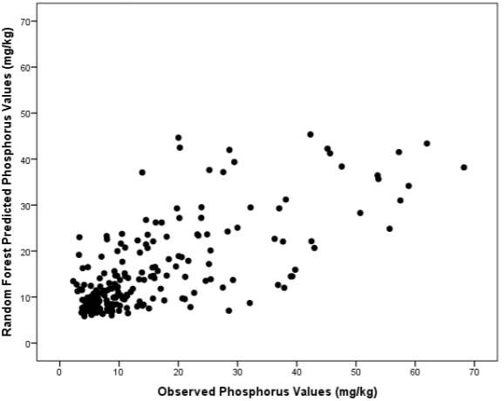
Methodology for Predicting HABs
Use random forests to model key algae growth variables from spectral data
Soil phosphorus & nitrogen content may be estimated using LAI, EVI, GEMI, and GVI indices (R² = 0.7) ¹⁰
Temperature may be estimated from MODIS band 20-23
Solar irradiance may be estimated from raw VIS reflectance
Use ARIMA models to forecast and flag model deviations as indicators of HABs
[10] MacDougall, M.J., Waller, M.K.E. 2018. Remote Sensing of Terrestrial Phosphorus at a Watershed Scale: A Case Study from the Pefferlaw/Uxbridge and Beaver Sub-watersheds of Lake Simcoe – Technical Report. Project LS-16-17-004. St. Lawrence River Institute of Environmental Sciences, Cornwall, ON

Slide 13
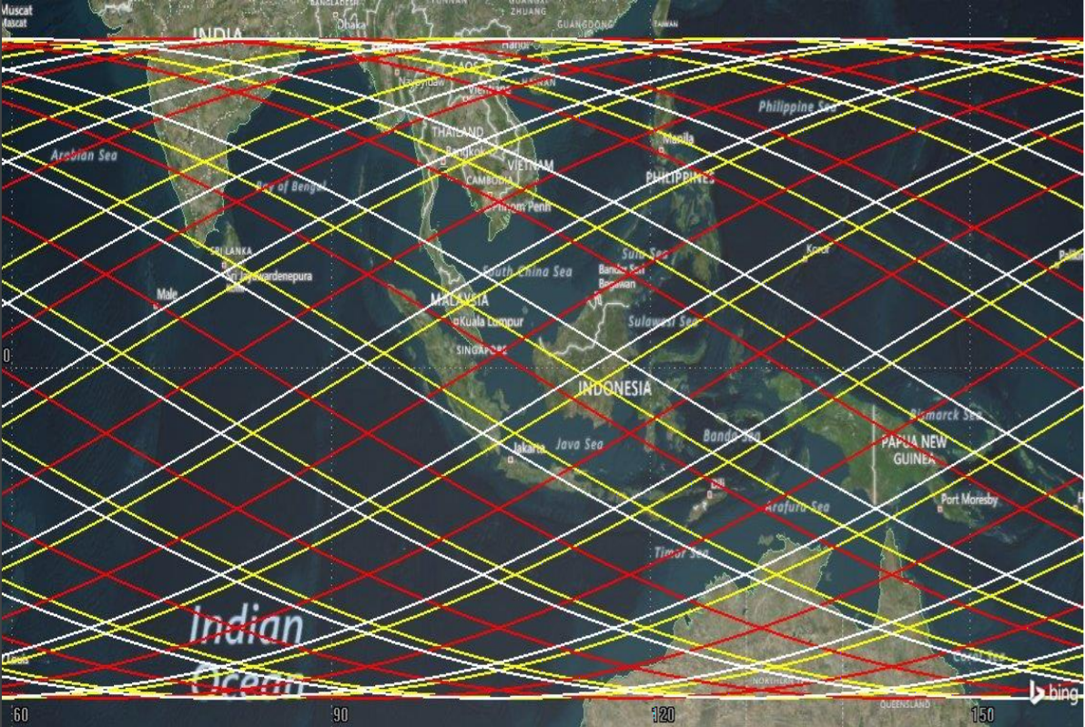
Improved Space Segment for Equatorial Regions
Frequent (~3/day) satellite coverage of equatorial countries is difficult
Near-equatorial orbits (NeqO) are not sun-synchronous, making earth observation difficult
Multiple sun-synchronous satellites are needed – CubeSat constellations can provide adequate coverage at lower cost
[img] Development of Microsatellite in Monitoring Initial Harmful Algal Bloom (HAB). Tan Aik Kwan. 5th Mission Idea Contest, Nov. 2018, Strasbourg, France.

Slide 14


Thank You for Your Time
z

Slide 15
Spectral Angle Mapping (SAM) Classification ^{A1}
Input hyperspectral image data
Output classified false-colour image
Use spectral angle to compare image to reference
[A1] Rashmi S1 , Swapna Addamani1 , Venkat1 and Ravikiran S2. Spectral Angle Mapper Algorithm for Remote Sensing Image Classification. IJISET - International Journal of Innovative Science, Engineering & Technology, Vol. 1 Issue 4, June 2014

Slide 16
MODIS Data Specifications
Band | Wavelength (nm) | Resolution (m) | Primary Use
1 | 620–670 | 250 | Land/Cloud/ Aerosols Boundaries
2 | 841–876 | 250
3 | 459–479 | 500 | Land/Cloud/ Aerosols Properties
4 | 545–565 | 500
5 | 1230–1250 | 500
6 | 1628–1652 | 500
7 | 2105–2155 | 500
Orbit: 705 km, 10:30 a.m. descending node (Terra) or 1:30 p.m. ascending node (Aqua), sun-synchronous, near-polar, circular
Scan Rate: 20.3 rpm, cross track
Swath Dimensions: 2330 km (cross track) by 10 km (along track at nadir)
Quantization: 12 bits
Spatial Resolution: 250 m (bands 1-2), 500 m (bands 3-7), 1000 m (bands 8-36)

